Slide 1

Milestone Project 2
SECTION

Slide 2
Complete Python Bootcamp
Now that you’ve learned about OOP, let’s test your new skills with another Milestone Project.
To warm-up, we will first guide you through creating a simple card game, then you will attempt the 2nd Milestone Project Exercise.

Slide 3
WARM UP PROJECT

Slide 4
Complete Python Bootcamp
To warm up for the 2nd Milestone Project we will recreate the card game called “War”.
Let’s have a quick overview of the game.

Slide 5
Complete Python Bootcamp
To warm up for the 2nd Milestone Project we will recreate the card game called “War”.
Let’s have a quick overview of the game.
wikipedia.org/wiki/War_(card_game)

Slide 6
Complete Python Bootcamp
DECK

Slide 7
Complete Python Bootcamp
DECK
ONE
TWO

Slide 8
Complete Python Bootcamp
ONE
TWO

Slide 9
Complete Python Bootcamp
JACK
KING
ONE
TWO

Slide 10
Complete Python Bootcamp
JACK
KING
ONE
TWO

Slide 11
Complete Python Bootcamp
JACK
<
KING
ONE
TWO

Slide 12
Complete Python Bootcamp
JACK
KING
ONE
TWO

Slide 13
Complete Python Bootcamp
ONE
TWO
TWO

Slide 14
Complete Python Bootcamp
JACK
==
JACK
ONE
TWO

Slide 15
Complete Python Bootcamp
==
ONE
TWO

Slide 16
Complete Python Bootcamp
JACK
KING
ONE
TWO

Slide 17
Complete Python Bootcamp
JACK
<
KING
ONE
TWO

Slide 18
Complete Python Bootcamp
JACK
<
KING
ONE
TWO

Slide 19
Complete Python Bootcamp
ONE
TWO

Slide 20
Complete Python Bootcamp
TWO

Slide 21
Complete Python Bootcamp
The “war” process can be repeated in this case of back to back ties.
To construct this game, we will create:
Card Class
Deck Class
Player Class
Game Logic

Slide 22
Let’s get started!

Slide 23
Card Class

Slide 24
Deck Class

Slide 25
Complete Python Bootcamp
Deck Class
Instantiate a new deck
Create all 52 Card objects
Hold as a list of Card objects
Shuffle a Deck through a method call
Random library shuffle() function
Deal cards from the Deck object
Pop method from cards list

Slide 26
Complete Python Bootcamp
Deck Class
We will see that the Deck class holds a list of Card objects.
This means the Deck class will return Card class object instances, not just normal python data types.
Let’s get started!

Slide 27
Player Class

Slide 28
Complete Python Bootcamp
Player Class
This class will be used to hold a player’s current list of cards.
A player should be able to add or remove cards from their “hand” (list of Card objects).

Slide 29
Complete Python Bootcamp
Player Class
We will want the player to be able to add a single card or multiple cards to their list, so we will also explore how to do this in one method call.

Slide 30
Complete Python Bootcamp
Player Class
The last thing we need to think about is translating a Deck/Hand of cards with a top and bottom, to a Python list.
Let’s try to visualize this.

Slide 31
Complete Python Bootcamp
Player Class will have a self.all_cards list

Slide 32
Complete Python Bootcamp
Player Class will have a self.all_cards list
A
B
C
cards = [“A”, “B”, “C”]

Slide 33
Complete Python Bootcamp
Player Class will have a self.all_cards list
A
B
C
[“A”, “B”, “C”]

Slide 34
Complete Python Bootcamp
A Player “plays” a card from the top
A
B
C
[“A”, “B”, “C”]

Slide 35
Complete Python Bootcamp
A Player “plays” a card from the top
B
C
[“A”, “B”, “C”]
A

Slide 36
Complete Python Bootcamp
A Player “plays” a card from the top
B
C
[“B”, “C”]
cards.pop(0)
A

Slide 37
Complete Python Bootcamp
Players will add cards to the “bottom”
B
C
[“B”, “C”]
W

Slide 38
Complete Python Bootcamp
Players will add cards to the “bottom”
B
C
[“B”, “C”]
W

Slide 39
Complete Python Bootcamp
Players will add cards to the “bottom”
B
C
[“B”, “C”, “W”]
cards.append(“W”)
W

Slide 40
Complete Python Bootcamp
Player adding multiple cards uses extend()
B
X
cards = [ “B”, “C” ]
new = [ “X”, “Z” ]
C
Z

Slide 41
Complete Python Bootcamp
Player adding multiple cards uses extend()
B
C
X
cards = [ “B”, “C” ]
new = [ “X”, “Z” ]
cards.extend(new)
Z

Slide 42
Complete Python Bootcamp
Player adding multiple cards uses extend()
B
C
X
cards = [ “B”, “C” ,“X”, “Z” ]
cards.extend(new)
Z

Slide 43
Complete Python Bootcamp
Don’t use append() or lists become nested!
B
C
X
cards = [ “B”, “C” ,[“X”, “Z”] ]
cards.append(new)
Z

Slide 44
Complete Python Bootcamp
Don’t use append() or lists become nested!
B
C
X
cards = [ “B”, “C” ,[“X”, “Z”] ]
cards.append(new)
Z

Slide 45
Let’s get started!

Slide 46
Game Logic
PART ONE

Slide 47
Complete Python Bootcamp
Creating the overall logic is often the hardest part of a project like this!
It is important to note, that we planned the classes around the upcoming logic, so in a real-world situation, you often think of both the logic and class structures simultaneously.

Slide 48
Complete Python Bootcamp
Let’s outline our logic for the game!

Slide 49
Complete Python Bootcamp
Let’s outline our logic for the game!
Player One
Player Two

Slide 50
Complete Python Bootcamp
Let’s outline our logic for the game!
Player One
New Deck
Player Two

Slide 51
Complete Python Bootcamp
Let’s outline our logic for the game!
Player One
Shuffle
Player Two

Slide 52
Complete Python Bootcamp
Let’s outline our logic for the game!
Player One
Split
Player Two

Slide 53
Complete Python Bootcamp
Let’s outline our logic for the game!
Player One
Player Two

Slide 54
Complete Python Bootcamp
Let’s outline our logic for the game!
Player One
Check for 0 Cards
Player Two

Slide 55
Complete Python Bootcamp
Let’s outline our logic for the game!
Player One
game_on = True
Player Two

Slide 56
Complete Python Bootcamp
Let’s outline our logic for the game!
Player One
while game_on
Player Two

Slide 57
Complete Python Bootcamp
Let’s outline our logic for the game!
Player One
while game_on
Player Two

Slide 58
Complete Python Bootcamp
Let’s outline our logic for the game!
Player One
while game_on
Player Two
<

Slide 59
Complete Python Bootcamp
Let’s outline our logic for the game!
Player One
while game_on
Player Two

Slide 60
Complete Python Bootcamp
Let’s outline our logic for the game!
Player One
while game_on
Player Two

Slide 61
Complete Python Bootcamp
Let’s outline our logic for the game!
Player One
while game_on
Player Two
==

Slide 62
Complete Python Bootcamp
Let’s outline our logic for the game!
Player One
while game_on
while at_war
Player Two
==

Slide 63
Complete Python Bootcamp
Let’s outline our logic for the game!
Player One
while game_on
while at_war
Player Two
<

Slide 64
Complete Python Bootcamp
Let’s outline our logic for the game!
Player One
while game_on
Check for 0 Cards
Player Two

Slide 65
Complete Python Bootcamp
Let’s outline our logic for the game!
Player One
while game_on
Game_on = False
Player Two

Slide 66
Complete Python Bootcamp
Let’s outline our logic for the game!
Player One
Player Two Wins!
Player Two

Slide 67
Game Logic
PART TWO

Slide 68
Game Logic
PART THREE

Slide 69
Complete Python Bootcamp
Now it’s time to check the player’s cards against each other.
There are lots of ways this can be done!
We have 3 situations:
Player One > Player Two
Player One < Player Two
Player One == Player Two

Slide 70
Complete Python Bootcamp
The way we will write this is with an if/elif/else within a while loop that assumes that a “war” has happened.
We will state at_war = False if the players resolve the match-up on the first drawn card, otherwise we will add cards to the current cards on the table.

Slide 71
Complete Python Bootcamp
The rules we’ll use in this version is if there is a tie, each player needs to draw 5 additional cards.
We’ll also say that a player loses if they don’t have at least 5 cards to play the war.
This logic is easily edited to fit any rule structure you want.

Slide 72
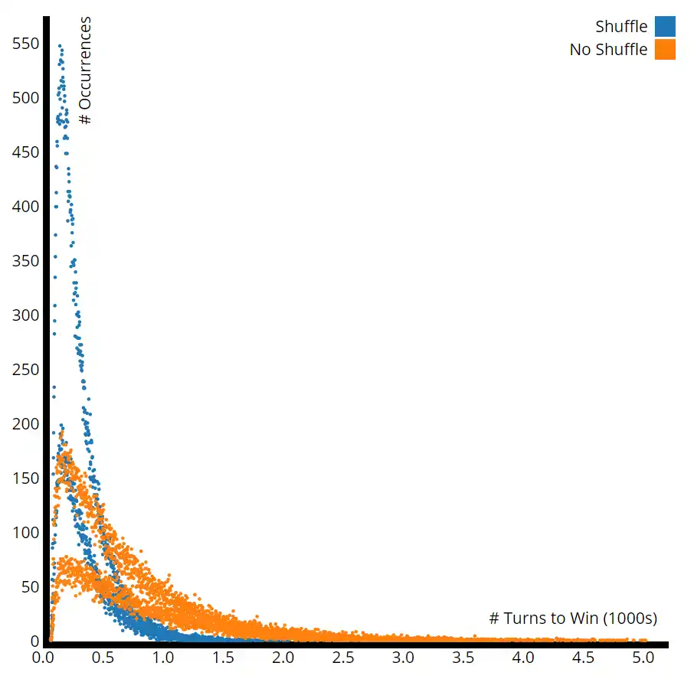
Complete Python Bootcamp

Slide 73
Complete Python Bootcamp
Let’s quickly explore this loop visually before we code it out!

Slide 74
Complete Python Bootcamp
Comparison Game Logic
while at_war

Slide 75
Complete Python Bootcamp
at_war = True
while at_war

Slide 76
Complete Python Bootcamp
at_war = True
while at_war
One > Two
Add cards to One
at_war = False
if

Slide 77
Complete Python Bootcamp
at_war = True
while at_war
One > Two
Add cards to One
at_war = False
if
One < Two
Add cards to Two
at_war = False
elif

Slide 78
Complete Python Bootcamp
at_war = True
while at_war
One > Two
Add cards to One
at_war = False
if
One < Two
Add cards to Two
at_war = False
elif
Check if players have enough cards
Draw additional cards
else

Slide 79
Complete Python Bootcamp
at_war = True
while at_war
One > Two
Add cards to One
at_war = False
if
One < Two
Add cards to Two
at_war = False
elif
Check if players have enough cards
Draw additional cards
else

Slide 80
Milestone Project 2

Slide 81
Complete Python Bootcamp
We’ve learned enough to start a second milestone project!
You can treat this project a few ways:
Code along project with the solutions.
Attempt the project on your own.
Use the workbook as a guide for the project on your own.

Slide 82
Complete Python Bootcamp
For this project you will use OOP to create a BlackJack Game with Python.
Let’s quickly go over the main idea of the game and discuss how OOP should be used for this project.

Slide 83
Complete Python Bootcamp
For our version of the game we will only have a computer dealer and a human player.
We start with a normal deck of cards, you will create a representation of a deck with Python.

Slide 84
Complete Python Bootcamp
COMPUTER DEALER
DECK
HUMAN PLAYER

Slide 85
Complete Python Bootcamp
COMPUTER DEALER
PLAYER PLACES A BET
DECK
HUMAN PLAYER

Slide 86
Complete Python Bootcamp
COMPUTER DEALER
Dealer starts with 1 card face up and 1 card face Down
DECK
Player starts with 2 cards face up
HUMAN PLAYER

Slide 87
Complete Python Bootcamp
COMPUTER DEALER
Dealer starts with 1 card face up and 1 card face Down
PLAYER GOES FIRST IN GAMEPLAY
DECK
Player starts with 2 cards face up
HUMAN PLAYER

Slide 88
Complete Python Bootcamp
COMPUTER DEALER
PLAYER GOAL: Get closer to a total value of 21 than the dealer does.
Possible Actions:
Hit (Receive another card)
Stay (Stop Receiving Cards)
We’ll ignore actions like “Insurance”, “Split”, or “Double Down”
HIT for more cards from DECK
DECK
HUMAN PLAYER

Slide 89
Complete Python Bootcamp
COMPUTER DEALER
PLAYER GOAL: Get closer to a total value of 21 than the dealer does.
Possible Actions:
Hit (Receive another card)
Stay (Stop Receiving Cards)
We’ll ignore actions like “Insurance”, “Split”, or “Double Down”
HIT for more cards from DECK
DECK
HUMAN PLAYER

Slide 90
Complete Python Bootcamp
COMPUTER DEALER
AFTER PLAYER TURN:
2. If player is under 21, dealer then hits until they either beat the player or the dealer busts.
DECK
Dealer HIT for more cards from DECK
HUMAN PLAYER

Slide 91
GAME END: PLAYER BUSTS
COMPUTER DEALER
AFTER PLAYER TURN:
If player keeps hitting goes over 21, they bust and lost the bet!
The game is then over and dealer collects the money.
DECK
SUM
OVER
21
HUMAN PLAYER

Slide 92
GAME END: Computer Beats Player
COMPUTER DEALER
Computer sum higher than player sum and still under 21.
AFTER PLAYER TURN:
2. If player is under 21, dealer then hits until they either beat the player or the dealer busts.
SUM
20
DECK
SUM
19
HUMAN PLAYER

Slide 93
GAME END: PLAYER WINS
COMPUTER DEALER
AFTER PLAYER TURN:
2. If player is under 21, dealer then hits until they either beat the player or the dealer busts.
SUM
OVER
21
DECK
HUMAN PLAYER

Slide 94
Complete Python Bootcamp
Special Rules:
Face Cards (Jack,Queen, King) count as a value of 10.
Aces can count as either 1 or 11 whichever value is preferable to the player.

Slide 95
Complete Python Bootcamp
Check out the resource links for other explanations of BlackJack for more information.
Let’s now explore the project itself and the workbook!

Slide 96
Milestone Project 2
Example Solution

